Slide 1
Hospital Management system
Cs257 group project -G5

Slide 2
About the Project
Overview
A web portal to manage Hospital
Project objective
Home Page
Registration
Login
Booking appointments
Separate access for doctors and admin
Show profile and History of users
Manage inventory and schedule and bills

Slide 3
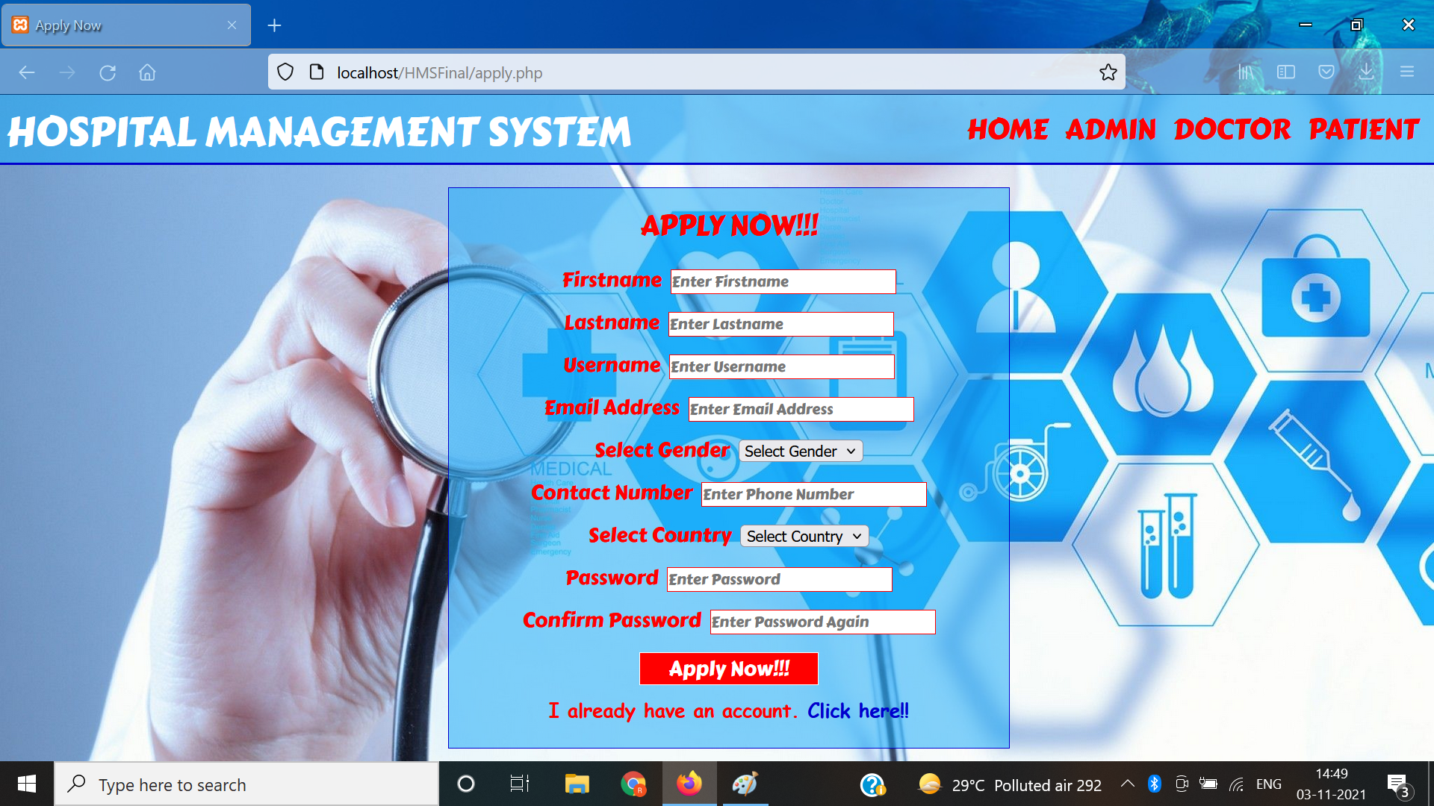
Application page

Slide 4
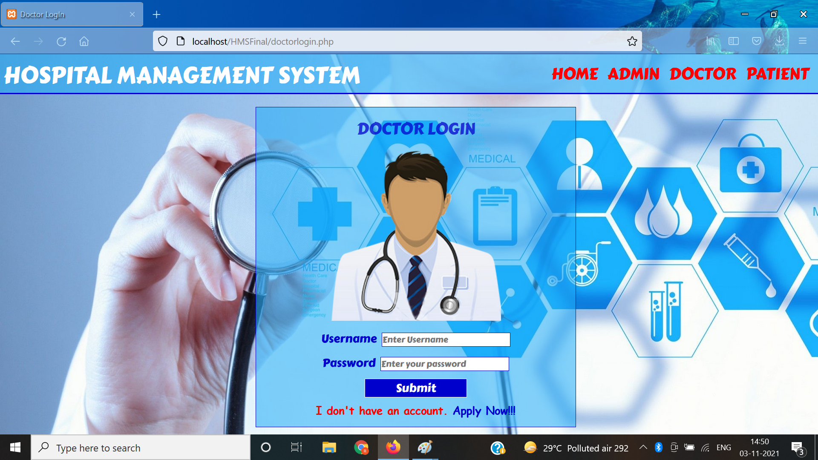
Doctor Login

Slide 5

Index Page

Slide 6

Admin Login Page

Slide 7
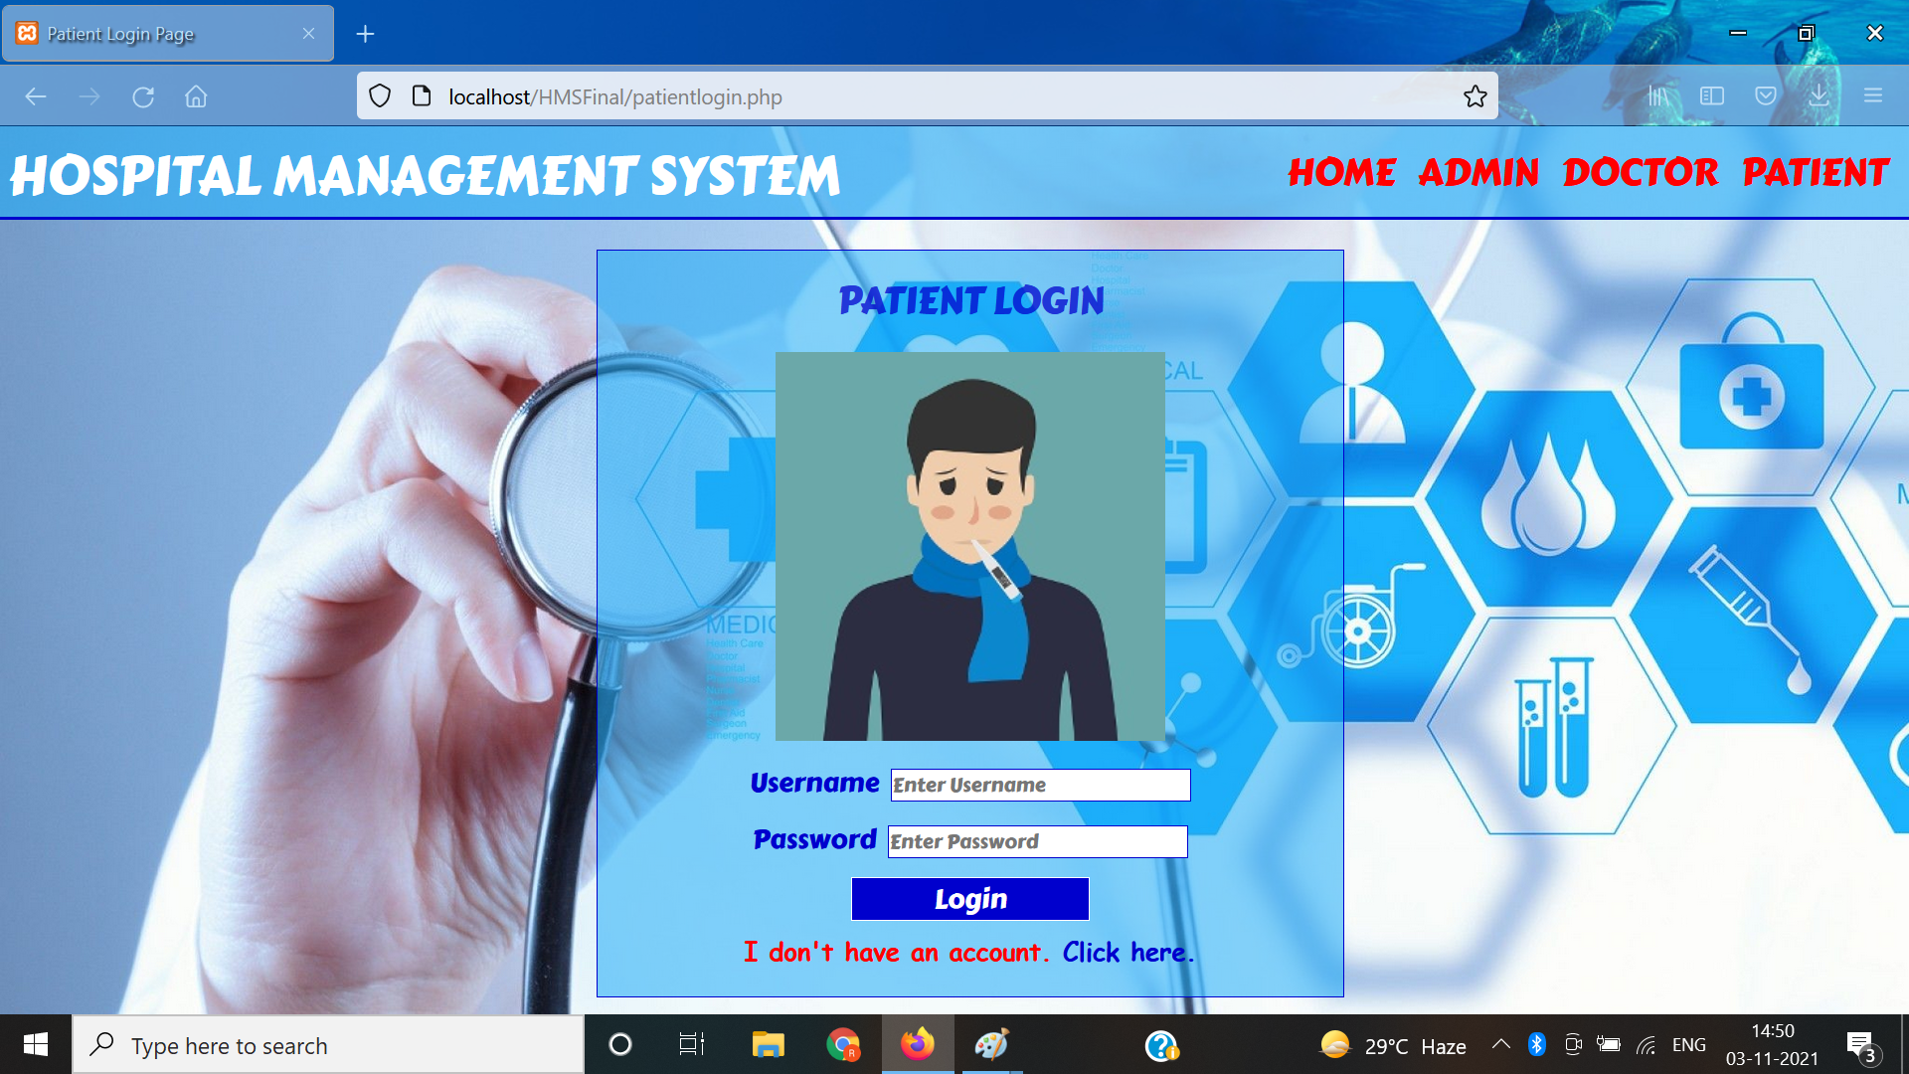
Patient Login

Slide 8
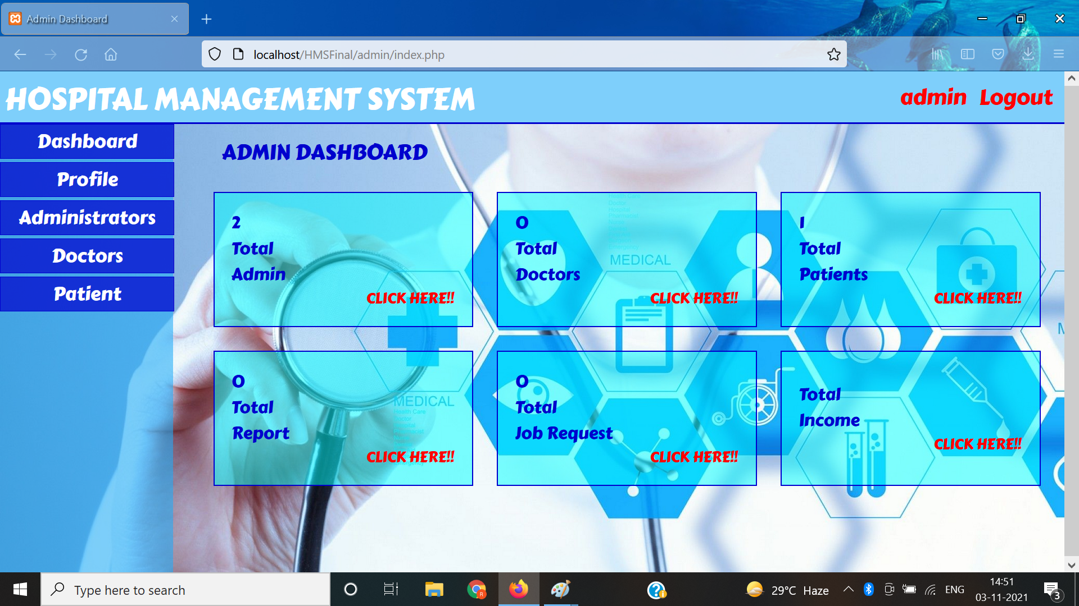
Admin Nav Preview

Slide 9
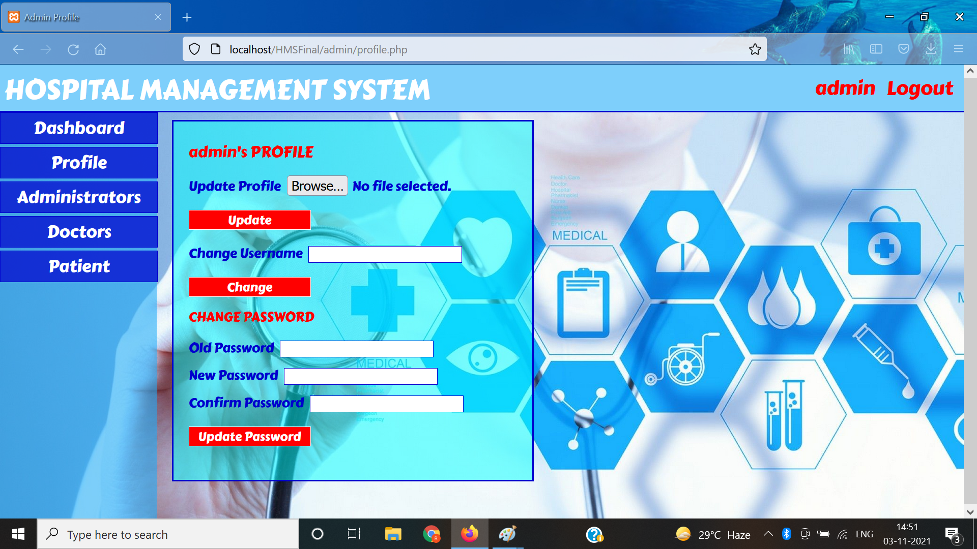
Update Admin Profile/change password

Slide 10
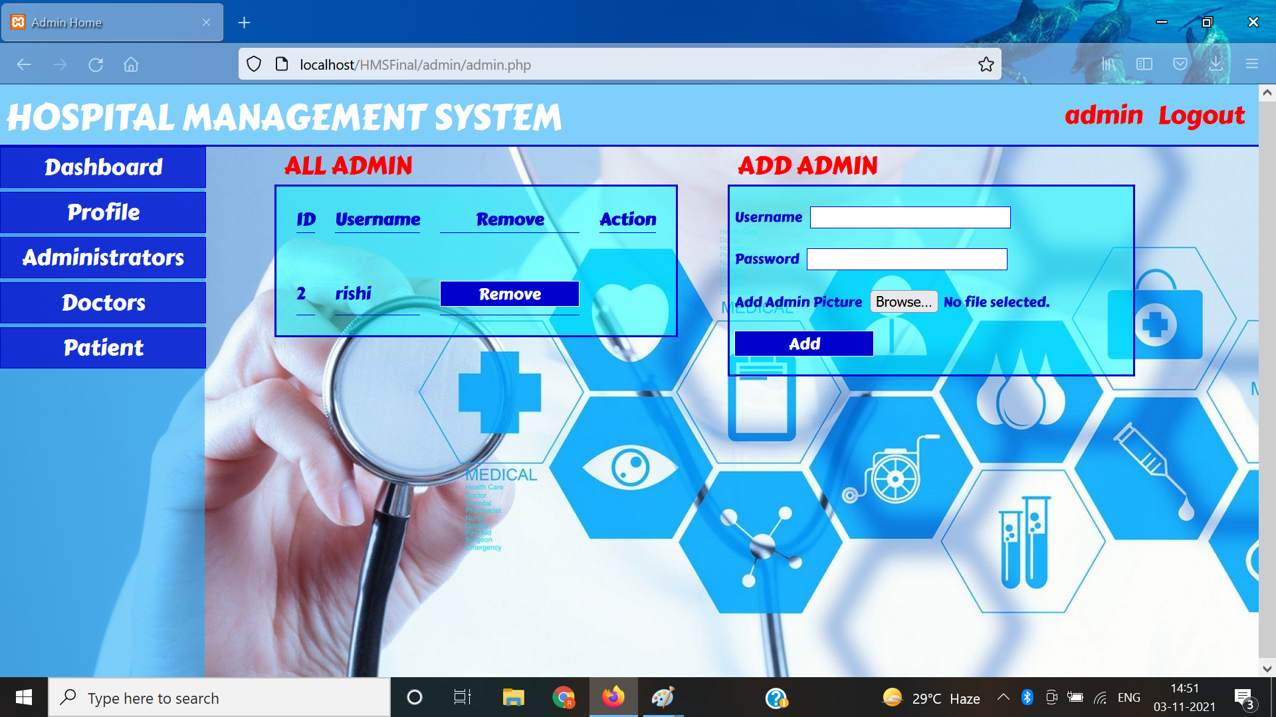
View/Add Admin

Slide 11
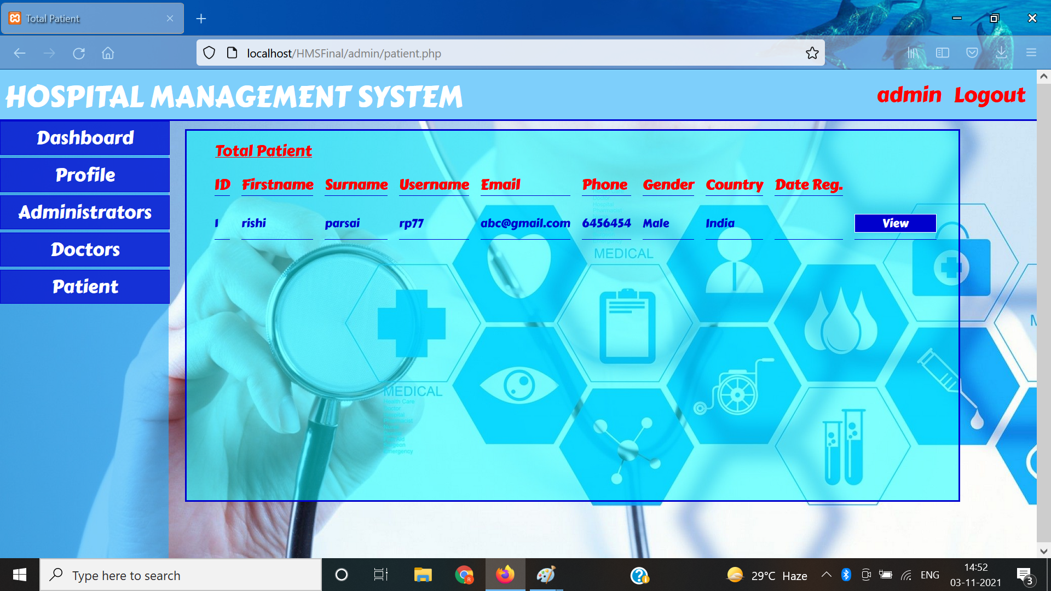
View/Manage Patients

Slide 12
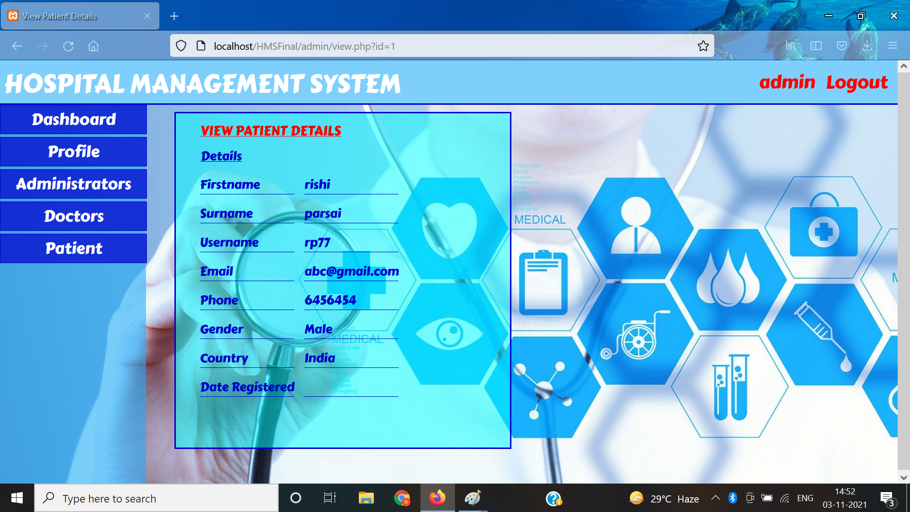
Patient Detail View

Slide 13
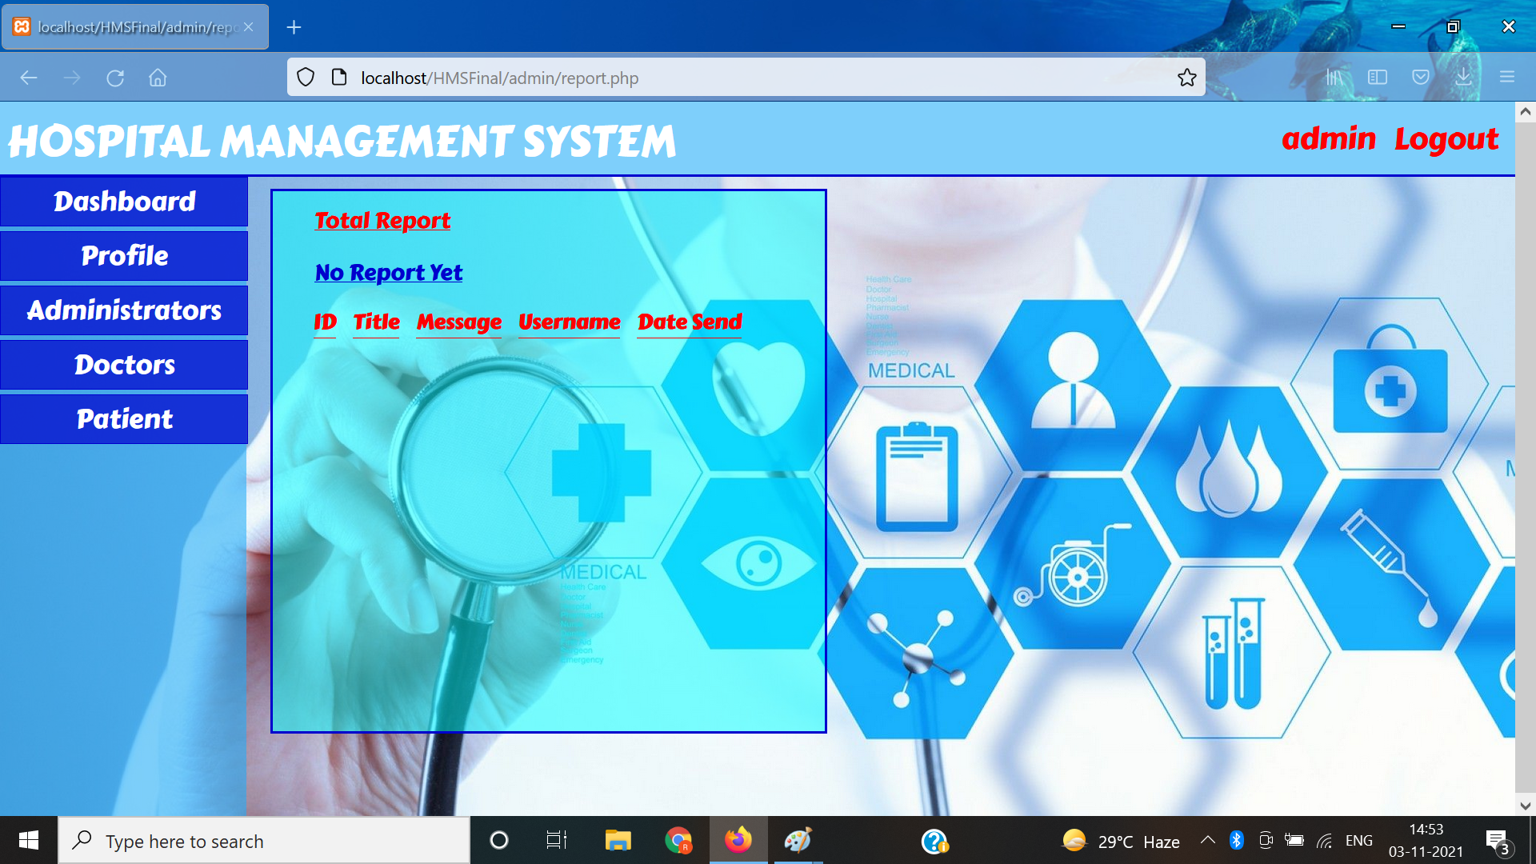
Report View/Manage Page

Slide 14
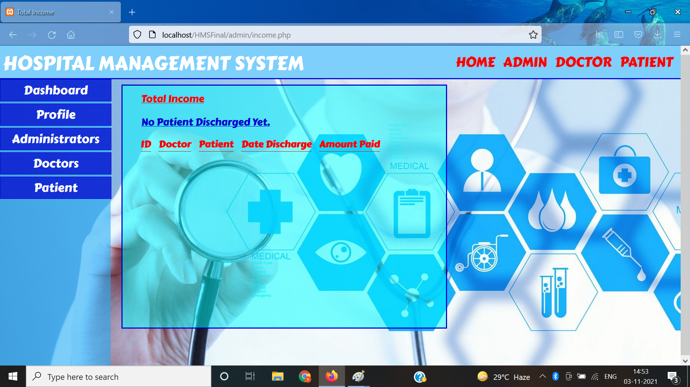
Hospital Finance Management

Slide 15
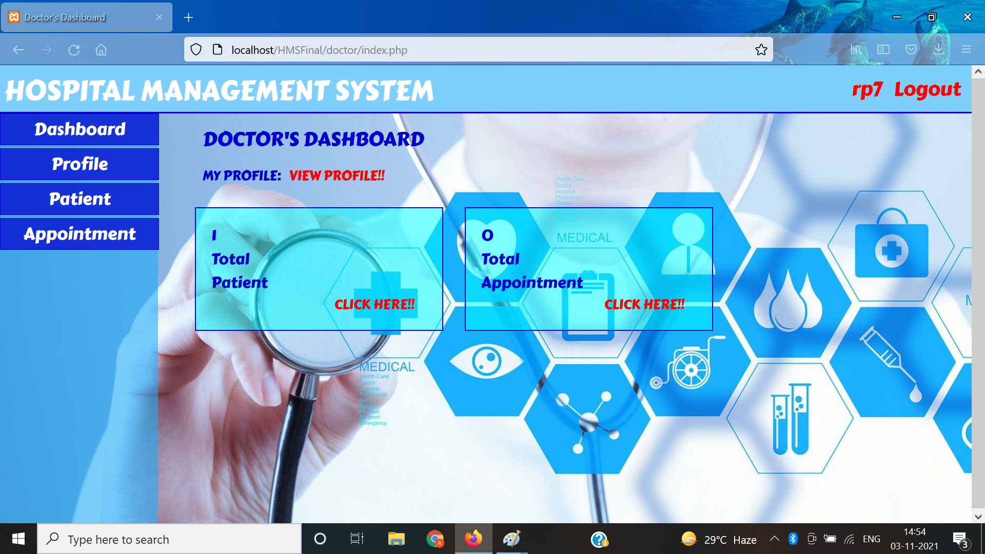
Doctor’s Dashboard

Slide 16
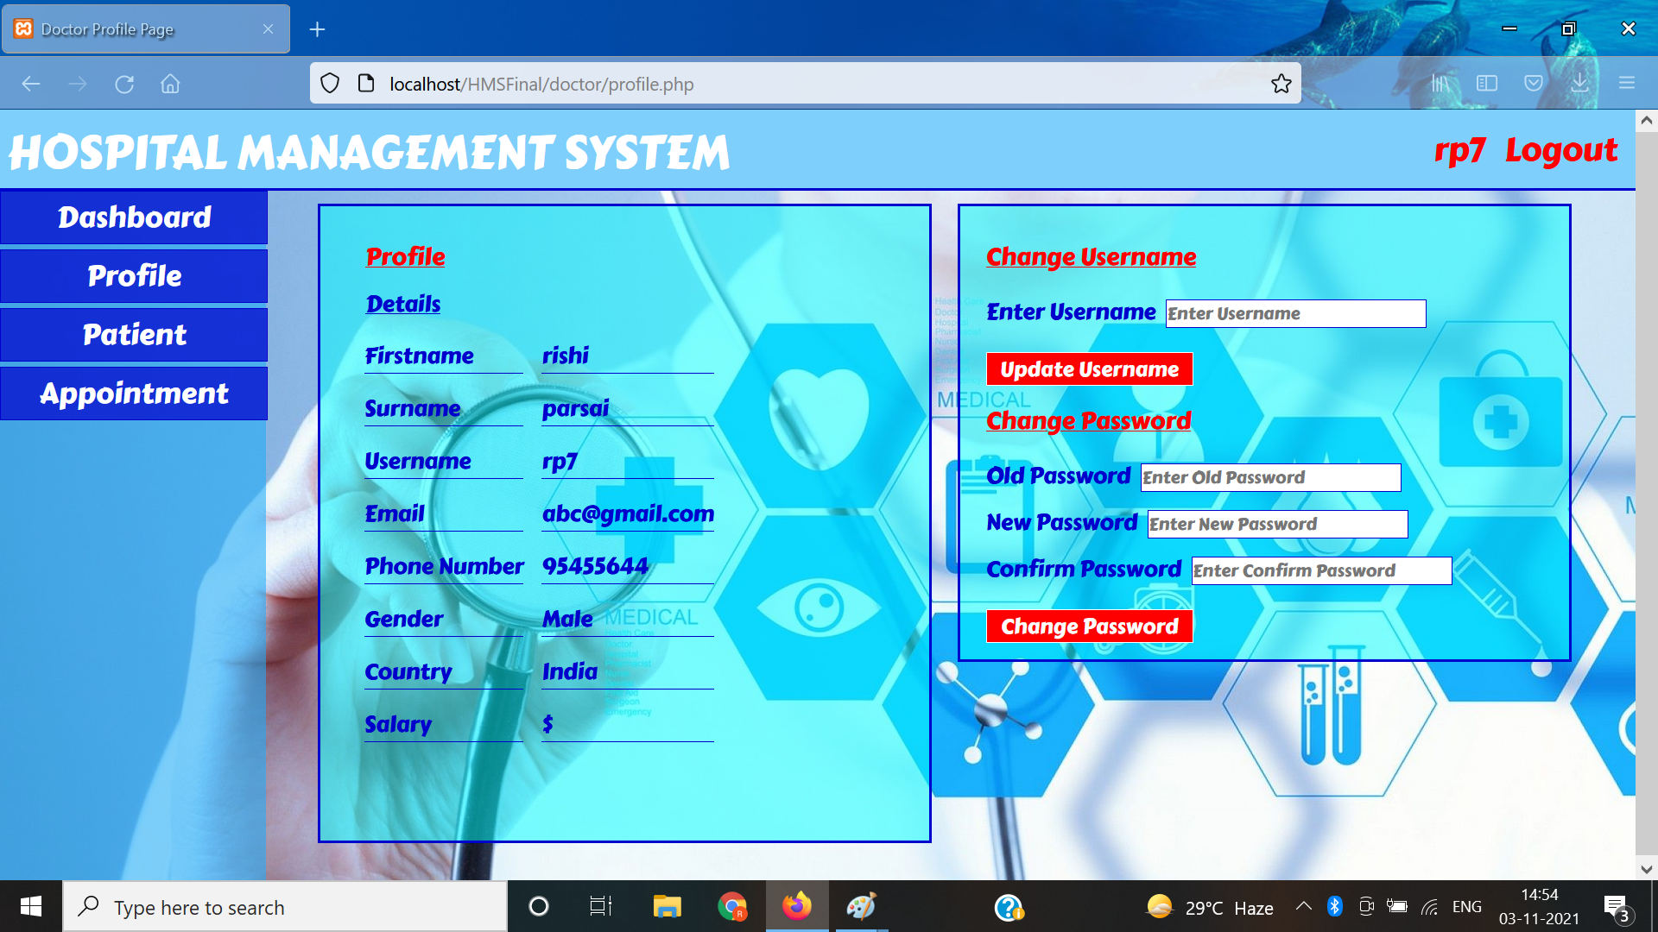
Doctor Profile View/Manage

Slide 17
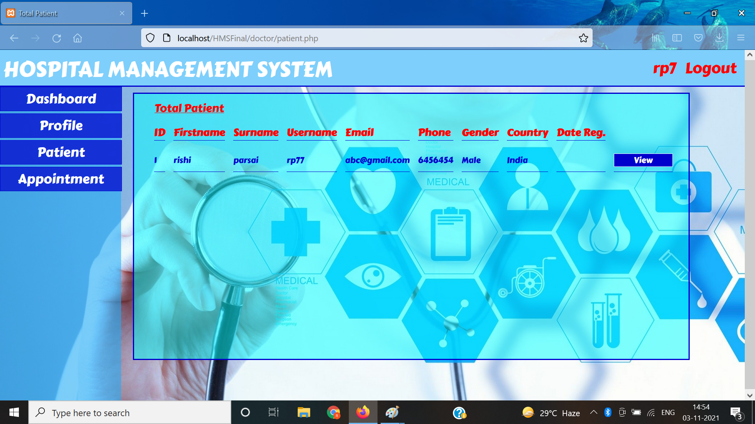
Patient View/Manage

Slide 18
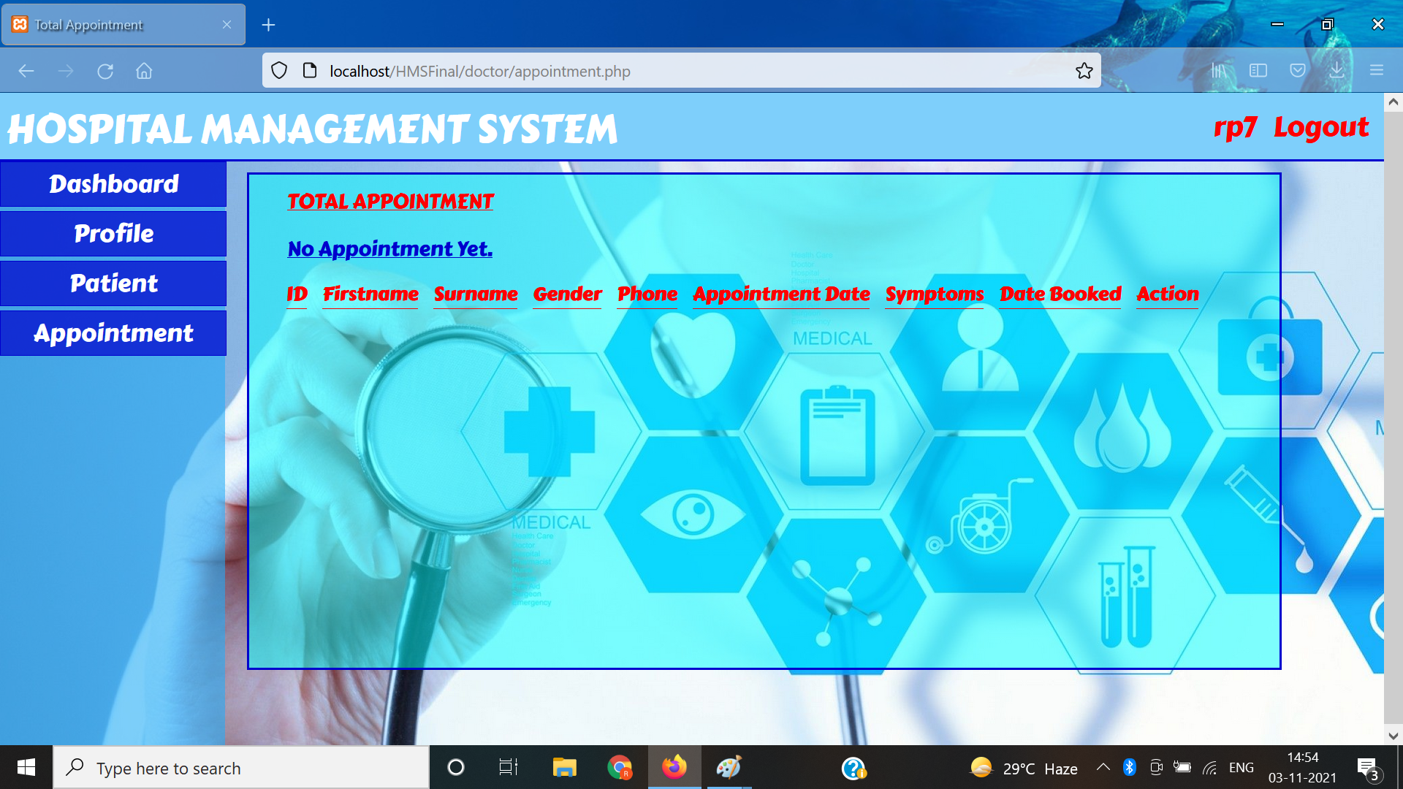
Appointment View/Manage

Slide 19
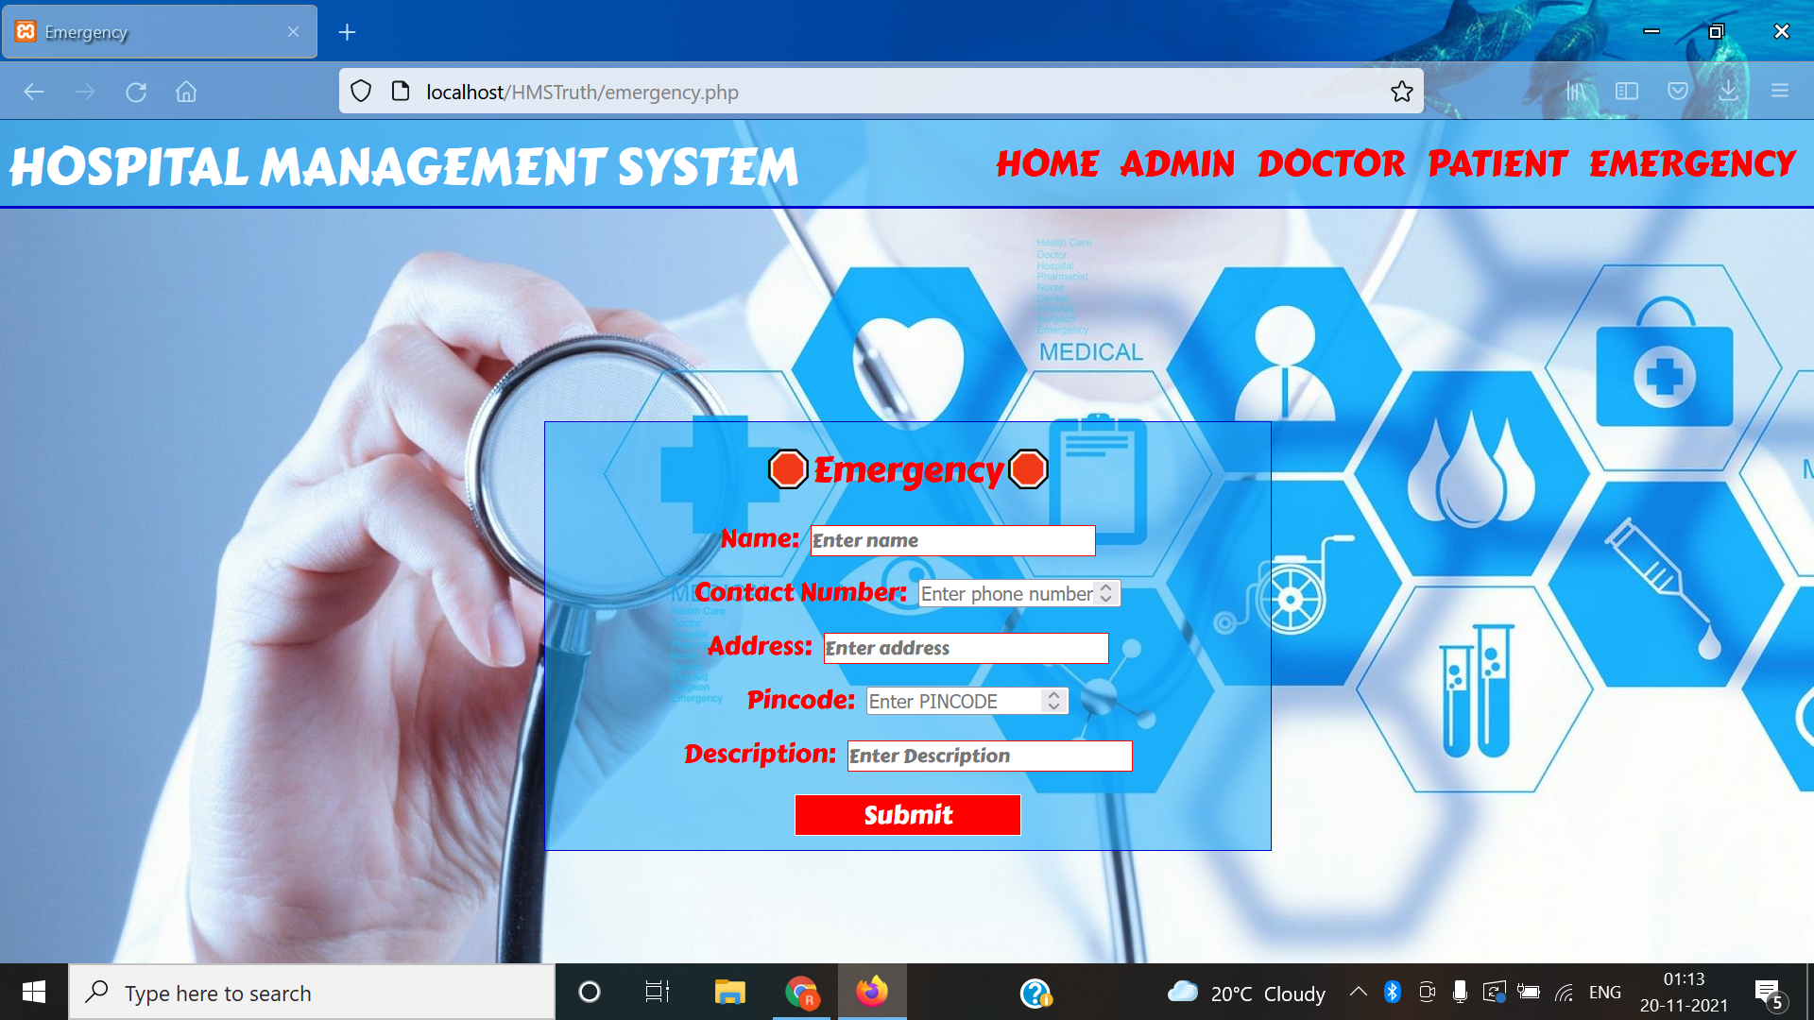
EMERGENCY (EXTRA FEATURE)

Slide 20
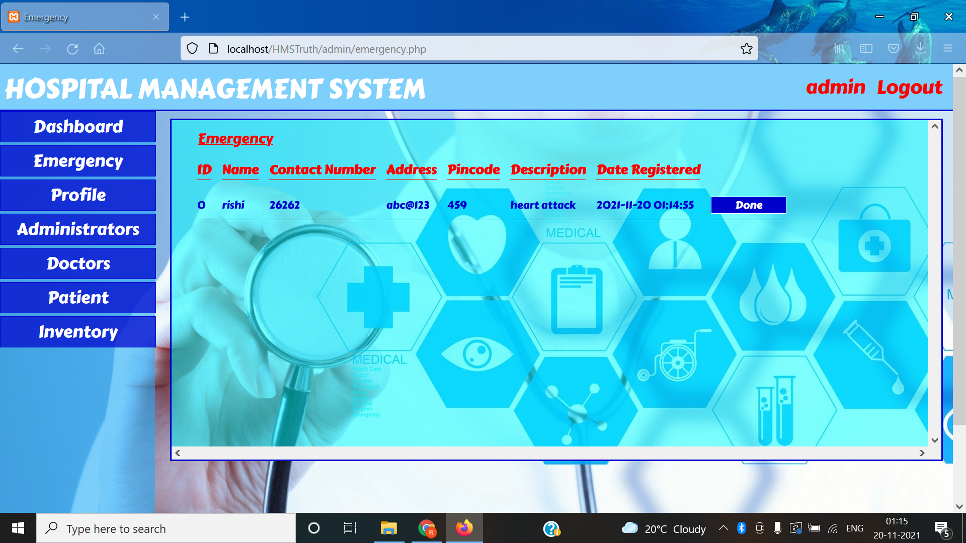
EMAERGENCY_ADMIN (EXTRA FEATURE)

Slide 21
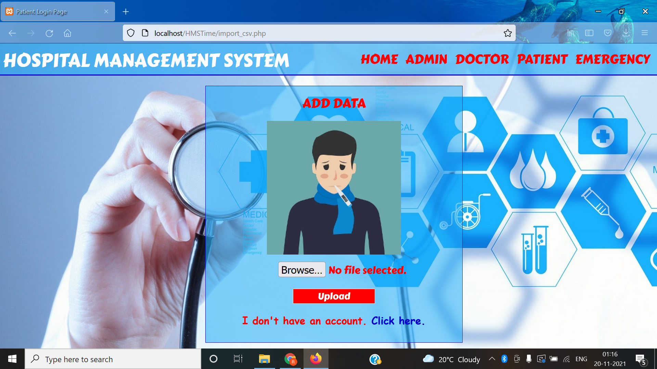
IMPORT CSV(EXTRA FEATURE)

Slide 22
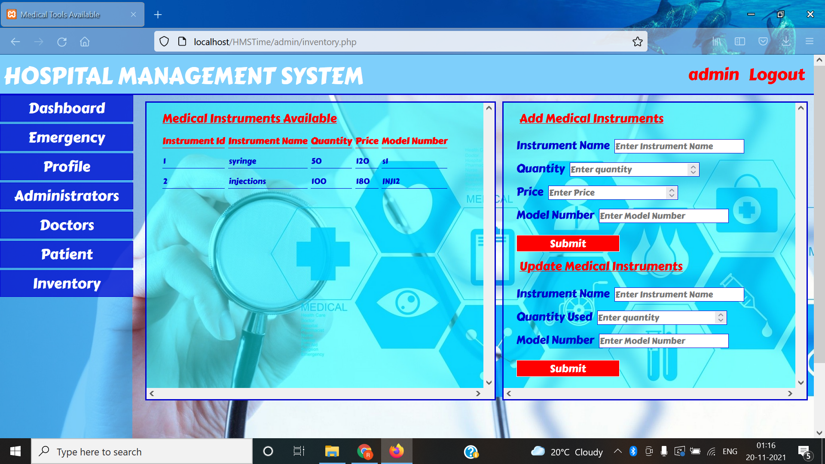
INVENTORY (EXTRA FEATURE)

Slide 23
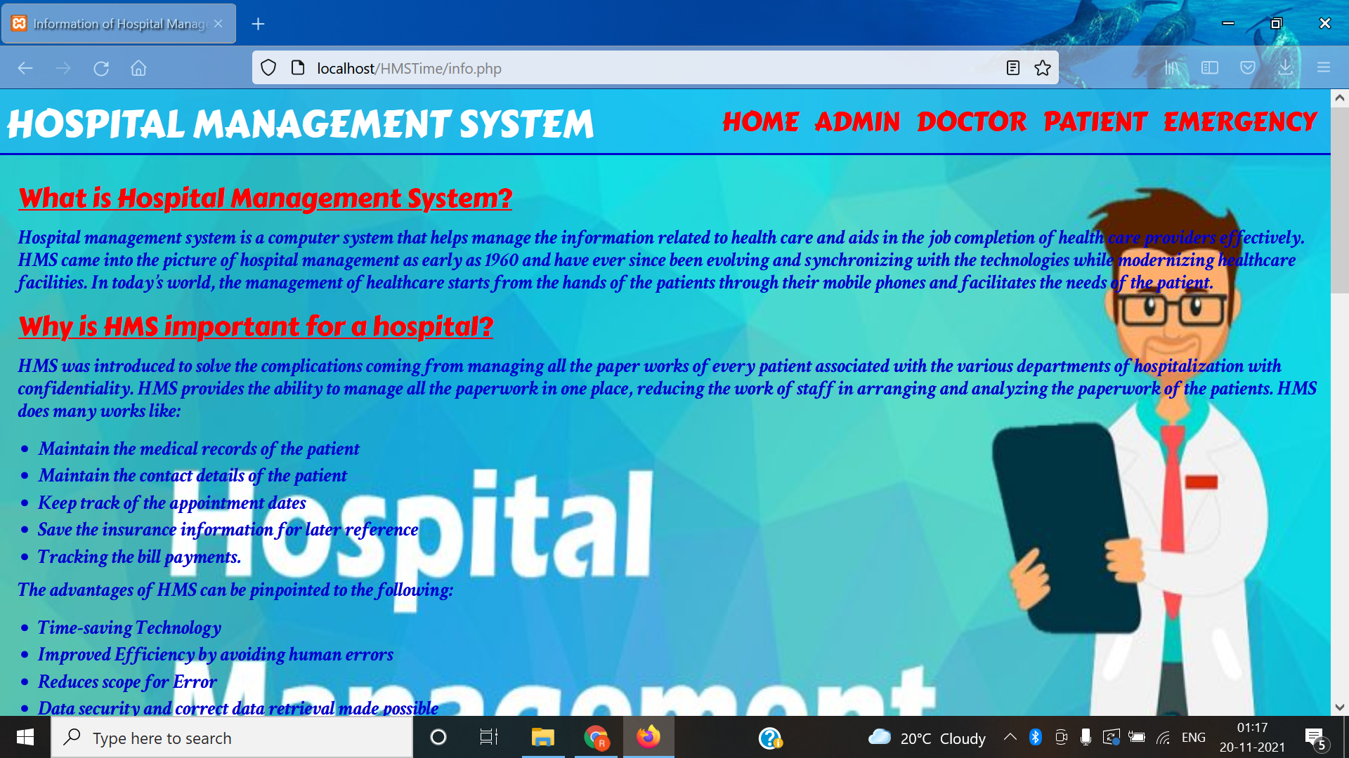
INFORMATION

Slide 24
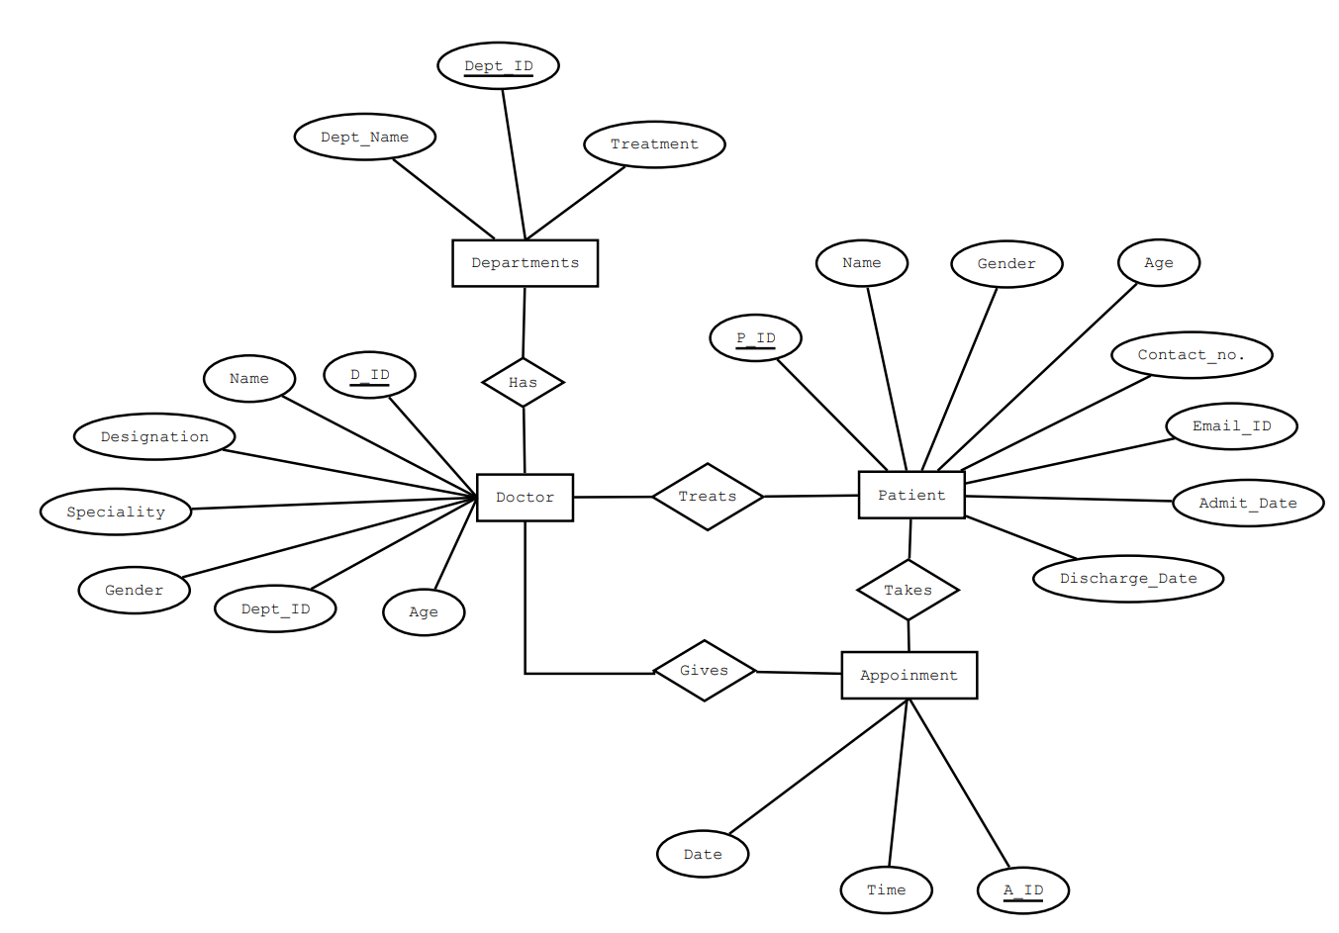
ER Diagram(Full Version in ZIP file)

Slide 25
Project timeline
1
2
3
4
5
6
Planning
Interface
Creating Database
Application development
Adding Extra Features
Making everything run together
Planning out things and skills needed and the ER Diagram
Creating Webpage use HTML and CSS
Creating a Database with its tables and attributes
Coding out the app which runs to add entries and commit all the other needed commands
Connecting and pre populating the database and making sure that everything runs properly without error
Adding provision for Emergency, Inventory Management and Automatic Patient Import/Export

Slide 26
Points to Discuss
What have you learnt and implemented till now?
Learnt :- we had to learn php and hosting a local server through XAMPP or WAMP.
Implemented :- aside from what previously done we made navigation panel, dashboard and feature to add and remove entities. Alongside locally hosted the PHP pages and connect it to a database
What is your Roadmap
We will proceed further by :- Completing the similar features for doctors and patients and trying to implementing one-click autofill/auto-add compatible for other HMS too.
Tools/Languages we used :- HTML,PHP,XAMPP,WAMP server, phpMyAdmin,etc
Outline :- Hospital Management System
Usability of project/examples
In Hospitals
In clinics
Automatic Form Filling and Database can be used in survey and further research
What will be done till next evaluation :-
Completing the similar features for doctors and patients
Ensuring that all the things work together properly and polishing

Slide 27
5. Contribution of Members
200001053 Nilay Ganvit
Structure of the Index Page, Navigation and the Dashboard
Coding of Index Page, Navigation and the Dashboard
Implementation of methods to add and remove entries in database and navigation
Adding of Import/Export Feature.
200001068 Rishi Parsai
CSS and all the Designing and UI of the webpage
Making the Structure more easily usable and customer friendly
Ensuring that functionality is compatible with Design
Formatting/Setting and Structural Integrity of Code and Styling.
200001069 Sanskar Verma
Combining, Downloading and Uploading parts of everyone else
Managing Resources and maintenance of versions of the project
Finding proper resources and materials
Coding Admin, Doctor and Patient and Adding Info/readme pages.
200001071 Saurabh Kumar Singh
Debugging and Removing Errors from the code
Maintaining Integrity of the Database and making the structure of the whole project
Hosting and Running the project while ensuring that all works together
Adding of emergency feature

Slide 28

Thank you!
200001053 Nilay Jayantibhai Ganvit
200001068 Rishi Parsai
200001069 Sanskar Verma
200001071 Saurabh Kumar Singh

